Slide 1
4pAinters by this is brazil
Bernardo Castro, Diogo Queiroz, Lucas Bittencourt

Slide 2
Briefing
Find yourself in European Renaissence and be the next great artist mankind has ever seen.
Pick one of the promising young painters and guide him to the ultimate glory.
Build your name among the artist and their patrons on this thrilling challenge to be the greatest artist of all.
Collect artifacts and use your unique skills that will aid you in your journey.
If your painting become a masterpiece, your name will be remembered for generations!
Are you up to the challenge ?

Slide 3
Mechanics
Game requires 2 to 4 players.
Action per turn based.
All players have unique habilities that gives advantages.
Power-ups will help throughout the gameplay.

Slide 4
Basic Rules
Initial setup:
The itens must be placed on the places assigned on the board
The player who went to a musem most recently begins
Each player draw a card to choose your painter to start the game and place the correspondent pin at the house
During the game:
Each player has 3 actions per turn and they choose among moving, complete paintings, buying new paints and using itens.
To complete the paintings, the player must use 3 actions at one of the painting studios or at house
Finishing the game:
After 20 turns or someone complete 4 paintings, the game ends.
The player with the most points win the game.

Slide 5
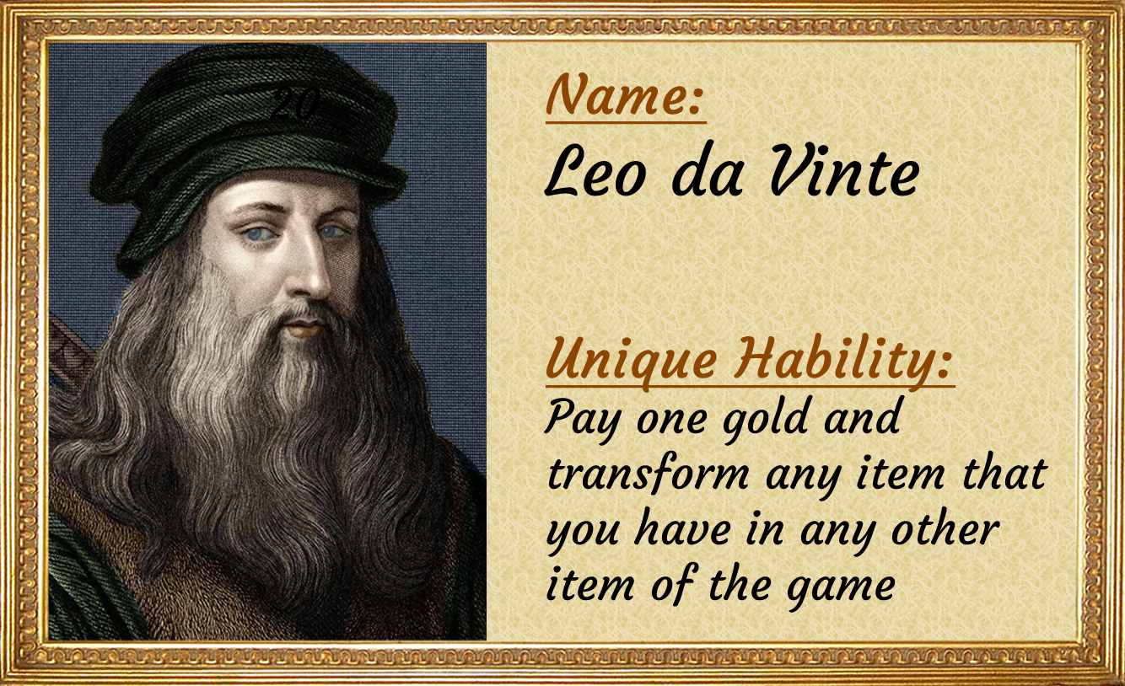
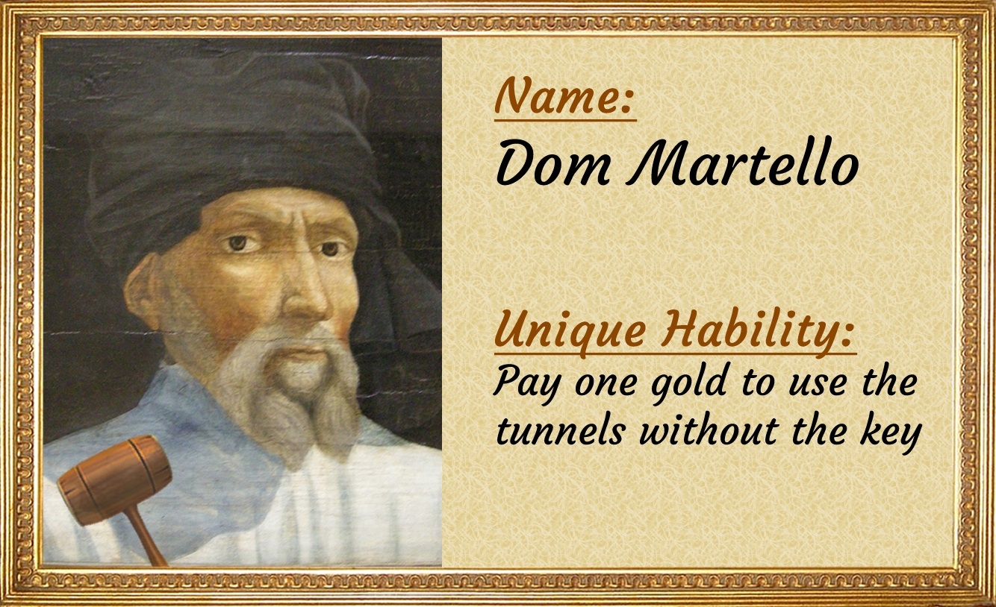
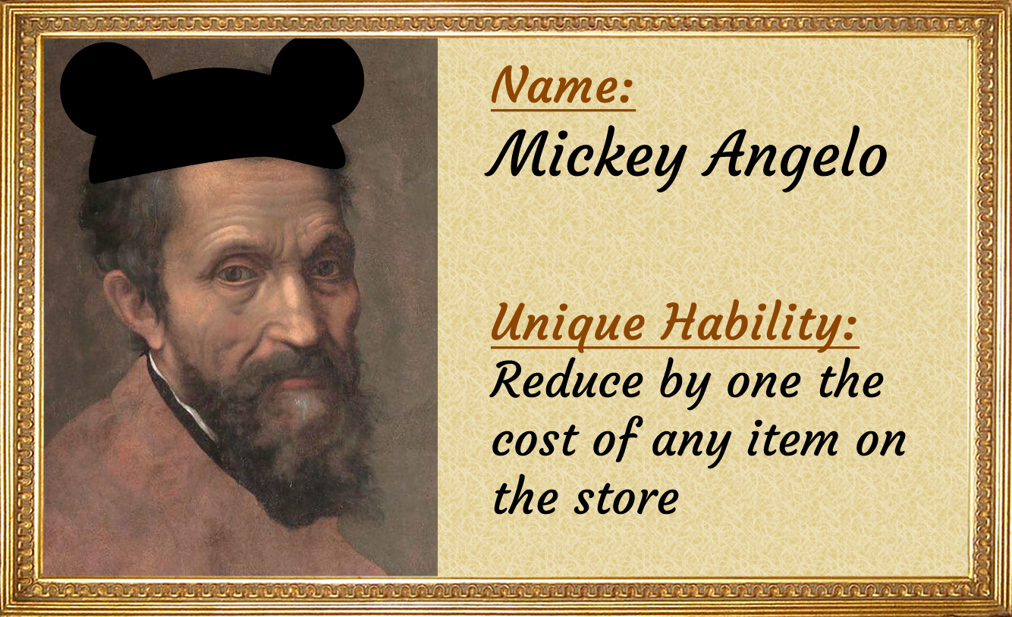
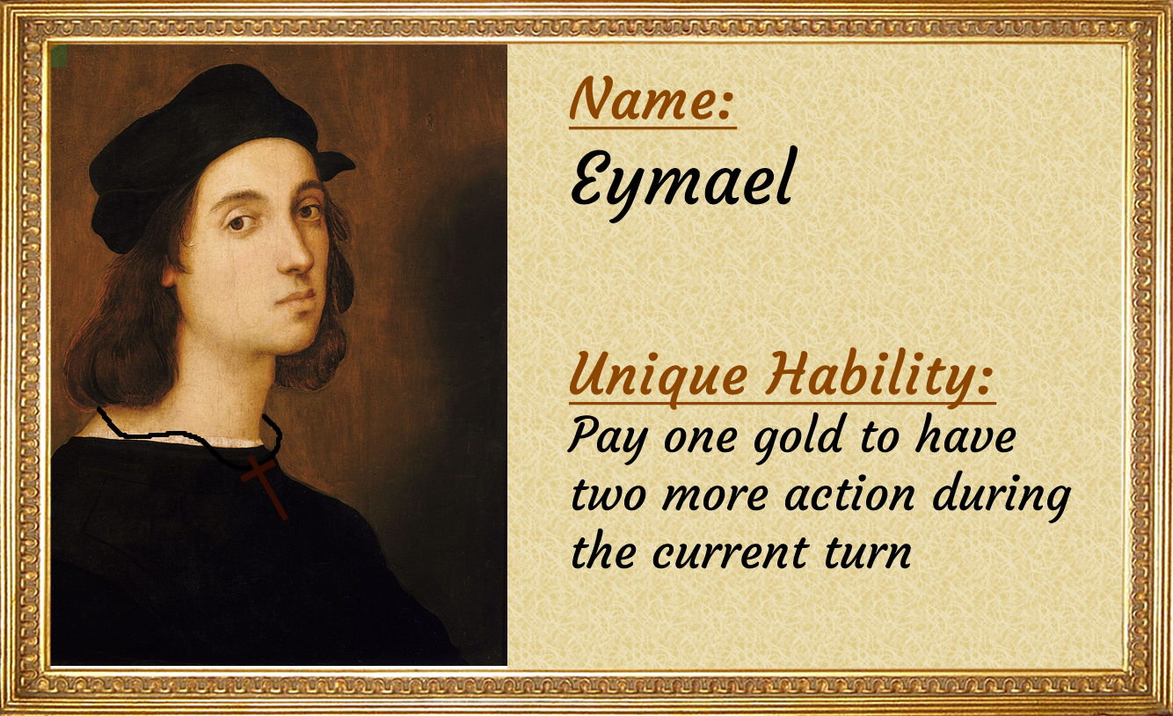
Characters

Slide 6
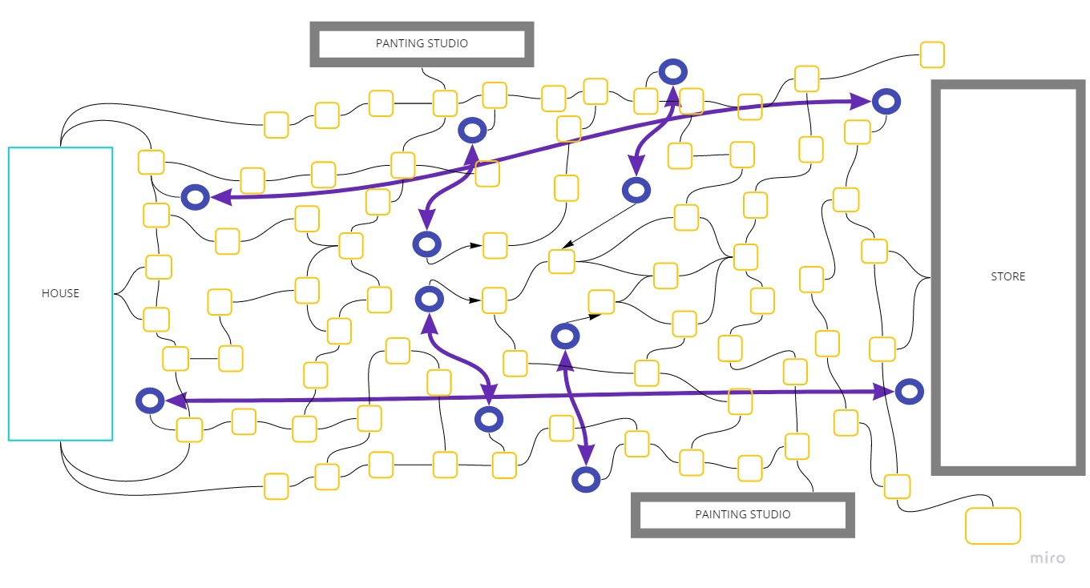
Board

Slide 7

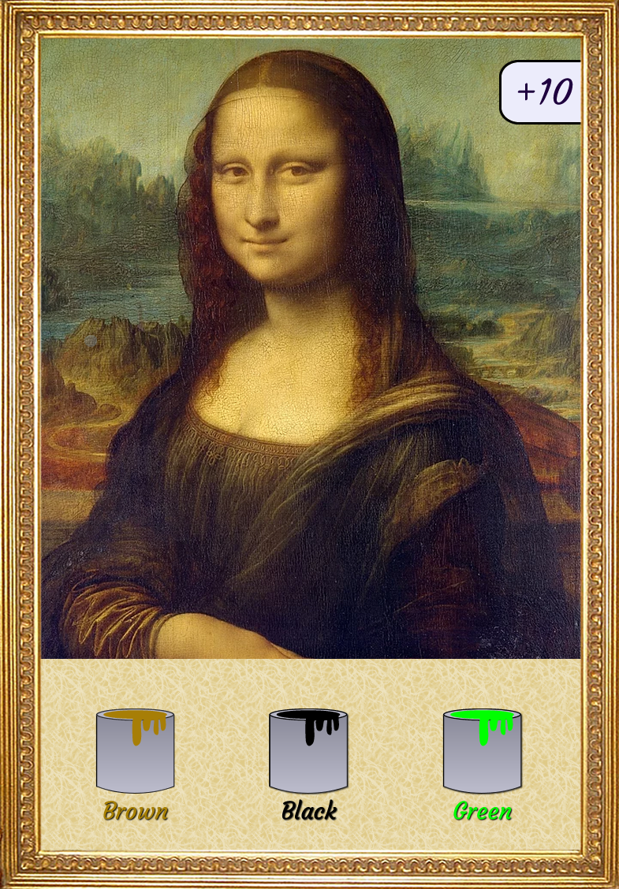
Paints
Each paint has 3 or 4 colors.
The score of paints depends on the colors to paint it.
Each player starts with 2 paints and can buy more paintings during the game

Slide 8


Itens
The most important itens are the colors.
Color is needed for creating the masterpiece. These itens can be found at the store or on the board.
Keys are special itens that give access to the catacombs. The catacombs can give the player na advantage.
Gold can be used for buying colors or other special itens.

Slide 9
Questions ?

Slide 10
Thank You!

